Slide 1
Who actually owns S&P500?
-- Sheetal Darekar

Slide 2
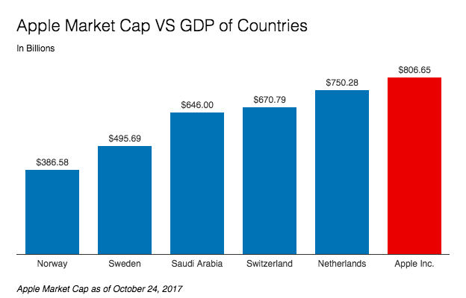
Do you guys know how big is Apple compared to some world GDPs?

Slide 3
Institutional Ownership
The amount of a company’s available stock owned by mutual or pension funds, insurance companies, investment firms, private foundations, endowments or other large entities that manage funds on the behalf of others.

Slide 4
Project Outline
Dataset
https://money.cnn.com (Scrapy)
https://www.nasdaq.com (Scrapy)
http://financials.morningstar.com/ (Selenium)
http://www.morningstar.com/ (Selenium)
Plot.ly
Seaborn

Slide 5
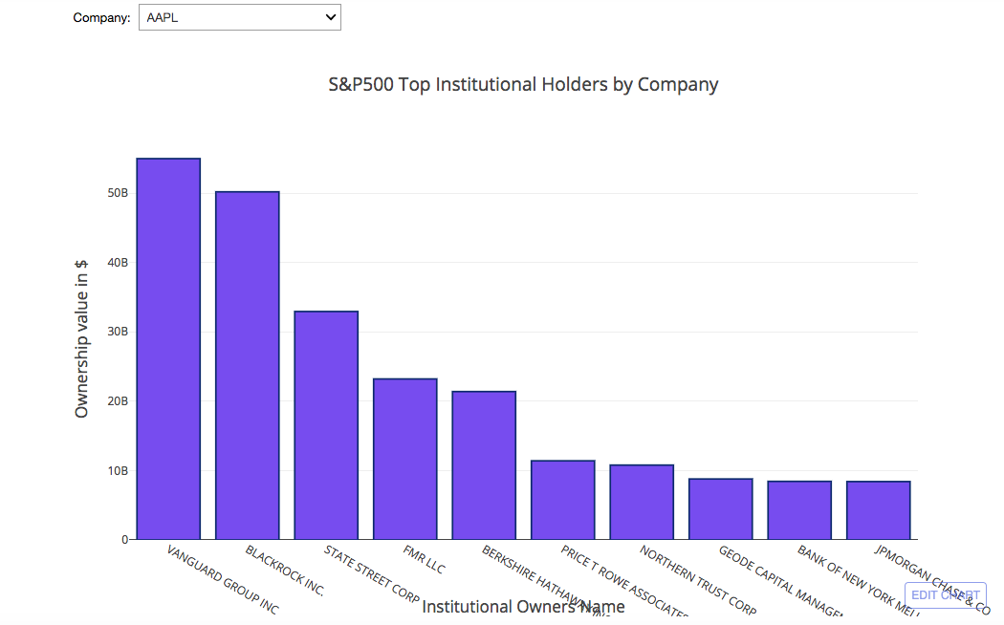
Institutional Owners by Company

Slide 6
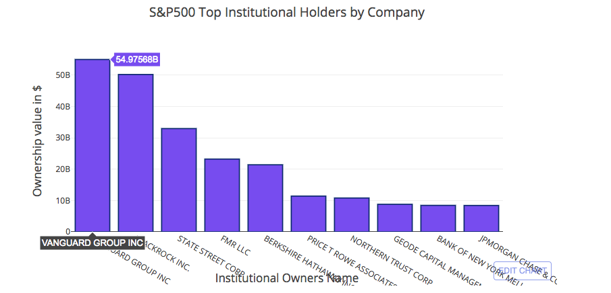
Top Institutional Owners of S&P 500

Slide 7
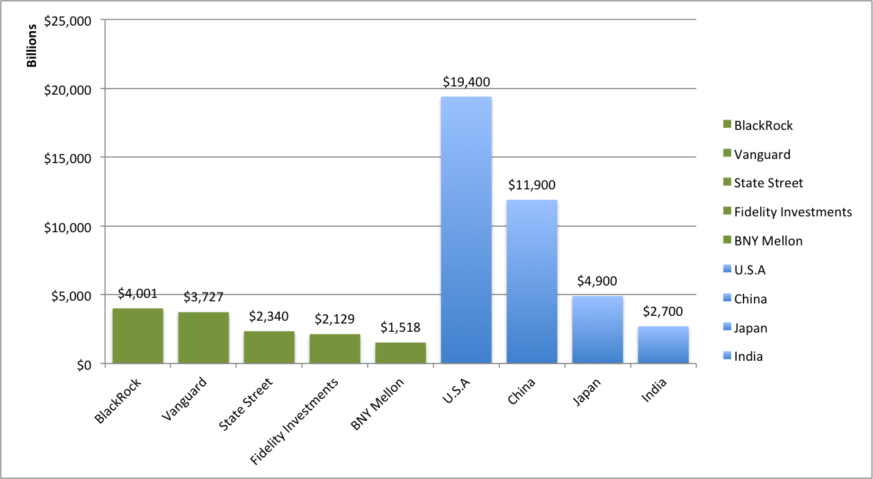
Comparison of Top S&P 500 Institutional Owners with few GDPs

Slide 8
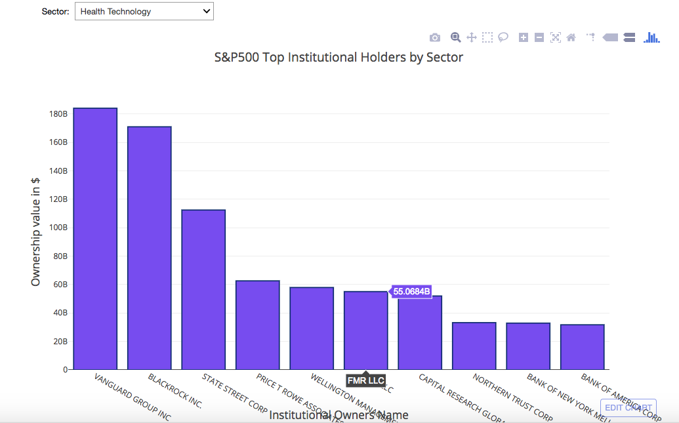
Institutional Owners by Sector

Slide 9
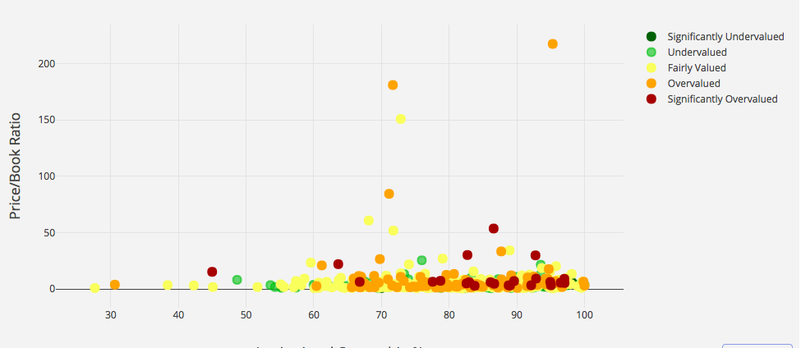
Price to Book Ratio v/s Institutional Ownership

Slide 10
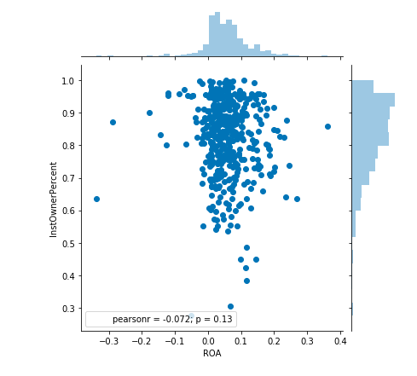
Institutional Owner Percentage v/s ROA

Slide 11
Conclusion
If a company wants to do really well in market, they need to have a high institutional ownership.
We have only SCRAPED the surface, these institutions own even larger shares in other instruments like bonds and government debt.

